Slide 1
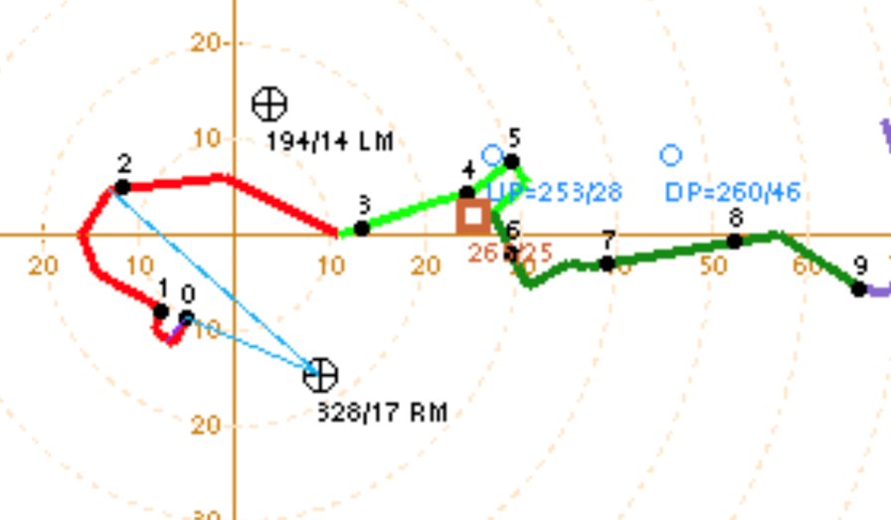
Supercell Dynamics and Pressure
Perturbations
Left-Mover
Right-Mover
L
L
Harry Weinman – Meteorologist, Storm Prediction Center
(harry.weinman@noaa.gov)
Cameron Nixon – Research Scientist, SPC / CIWRO
(cameron.nixon@noaa.gov)

Slide 2
During the next lectures, let’s explain:
Origins of midlevel updraft rotation (mesocyclone)
Dynamic pressure perturbations (non-linear and linear terms)
2a) Supercell propagation (and storm splitting)
2b) Why right-movers are sometimes favored over left-movers and vice versa

Slide 3
Origins of midlevel updraft rotation (mesocyclone)
See text

Slide 4
Start with
Crosswise Vorticity

Slide 5
An Updraft Emerges!
ω_{h}
Initial Updraft
ω_{h}
Inflow
(SR winds)
Inflow
Inflow not aligned with vortex tubes (crosswise vorticity)

Slide 6
Tilting of The Vortex Tubes
Updraft draws crosswise horizontal vorticity into the vertical (tilting)
Inflow

Slide 7
Tilting of The Vortex Tubes
ω_{h}
Initial Updraft
Inflow
(SR winds)
Inflow
Counter-rotating vorticity centers flank the updraft;
cyclonic to the right, anticyclonic to the left!

Slide 8
Tilting + Advection – Crosswise Vorticity
ω_{h}
Initial Updraft
Inflow
(SR winds)
Advection slightly shifts the vertical vorticity centers downshear
Does not fully explain midlevel updraft rotation – initial updraft not aligned with vertical vorticity!

Slide 9
Now
Streamwise Vorticity
ω_{h}
ω_{h}
ω_{h}

Slide 10
An Updraft Emerges!
ω_{h}
ω_{h}
ω_{h}
ω_{h}
Initial Updraft
Inflow
(SR winds)
Inflow
Inflow aligned with vortex tubes (streamwise vorticity!)

Slide 11
Tilting of The Vortex Tubes
Updraft draws streamwise horizontal vorticity into the vertical (tilting)
Inflow

Slide 12
Tilting of The Vortex Tubes
Updraft draws streamwise horizontal vorticity into the vertical (tilting)

Slide 13
Tilting + Advection – Streamwise Vorticity
ω_{h}
ω_{h}
ω_{h}
Initial Updraft
Inflow
(SR winds)
Cyclonic vorticity center induced in updraft!
(Anticyclonic vorticity is displaced from updraft)

Slide 14
Mesocyclone!
Inflow
Tilting + Advection of streamwise vorticity → Origin of midlevel rotation!

Slide 15
Dynamic Pressure Perturbations
See text

Slide 16
Non-Linear Dynamics Terms
2. Linear Dynamics Term

Slide 17
Non-Linear Terms
Straight Hodograph - Crosswise Vorticity

Slide 18
Tilting of The Vortex Tubes
L
Low pressure perturbations are induced in vertical vorticity centers
L

Slide 19
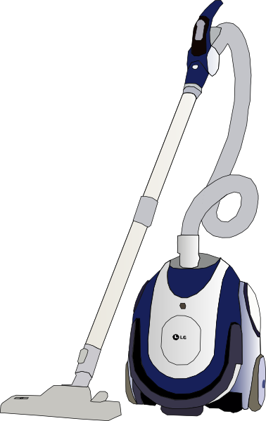
The Vacuum Cleaner Effect
These perturbation pressure deficits aloft act like vacuum cleaners, drawing air upward!

Slide 20
Two New ROTATING Updrafts Emerge!
ω_{h}
Splitting storms!
LM
LM
RM
Inflow
(SR winds)
RM
Inflow
Inflow
Results in two new updrafts that are now correlated with vertical vorticity and acquire rotation

Slide 21
Non-Linear Feedback Process Begins!
LM
RM
New updrafts stretch vorticity → strengthen vorticity → strengthen the updrafts → stronger stretching → stronger vacuums → stronger updrafts … non-linear feedback process!

Slide 22
Non-Linear Terms
Curved Hodograph
ω_{h}
ω_{h}
ω_{h}

Slide 23
Tilting + Advection of Streamwise Vorticity
Updraft draws streamwise vorticity into the vertical (tilting)
Inflow
Cyclonic vorticity center induced in updraft!
(Anticyclonic vorticity is displaced from updraft)

Slide 24
Tilting of The Vortex Tubes
L
Low pressure perturbation is induced in the vorticity center, which is centered on initial updraft!

Slide 25
The Vacuum Cleaner Effect
Vacuum sucks air upward from below!

Slide 26
Rotating Updraft
ω_{h}
ω_{h}
RM
Dominant right-mover; No split!
ω_{h}
Initial Updraft
Inflow
(SR winds)
Inflow
Initial updraft was correlated with the cyclonic vorticity
from the start – streamwise vorticity ingestion!

Slide 27
Non-Linear Feedback Process Begins!
RM
Same stretching, vacuum cleaner effect (non-linear feedback process) – but faster/more efficient owing to streamwise vorticity!

Slide 28
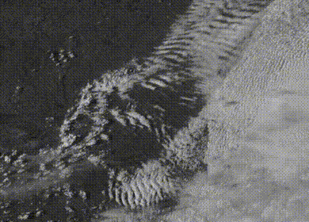
Non-Linear Takeaways
Summary:
In crosswise vorticity, storms split

Slide 29
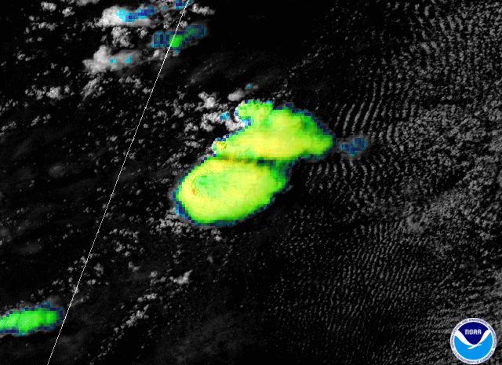
Non-Linear Takeaways
Summary:
Then, storms acquire some streamwise
vorticity and strengthen

Slide 30
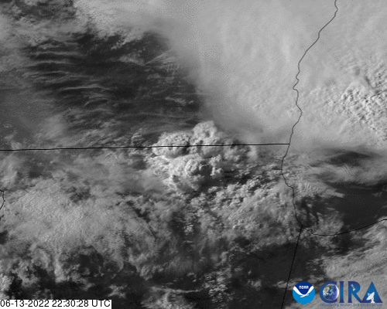
Non-Linear Takeaways
Summary:
In streamwise vorticity, no splitting!

Slide 31
Non-Linear Terms
The tilting of crosswise vorticity results in:
Immediate rotation for initial updraft
Vertical vorticity on flanks of initial updraft and storm splitting
A high pressure perturbation and downward motion
Inflow

Slide 32
Non-Linear Terms
The tilting of crosswise vorticity results in:
Immediate rotation for initial updraft
Vertical vorticity on flanks of initial updraft and storm splitting
A high pressure perturbation and downward motion
LM
RM
Inflow
Inflow

Slide 33
Non-Linear Terms
Why does streamwise vorticity support immediate updraft rotation?
Because cyclonic vorticity is more efficient than anticyclonic vorticity
Stretching is stronger
The vertical vorticity is aligned with the initial updraft
RM
Inflow

Slide 34
Non-Linear Terms
Why does streamwise vorticity support immediate updraft rotation?
Because cyclonic vorticity is more efficient than anticyclonic vorticity
Stretching is stronger
The vertical vorticity is aligned with the initial updraft
RM
Inflow

Slide 35
Non-Linear Terms
What is the significance of low pressure perturbations aloft?
Can limit cell splitting
Can suppress downdrafts
Can dynamically lift inflow air to
to the LFC, even with CIN
L
L

Slide 36
Non-Linear Terms
What is the significance of low pressure perturbations aloft?
Can limit cell splitting
Can suppress downdrafts
Can dynamically lift inflow air to
to the LFC, even with CIN

Slide 37
Non-Linear Dynamics Terms
2. Linear Dynamics Term

Slide 38
Linear Dynamics Term
Updraft
H
L
Shear Vector

Slide 39
Dynamic Lifting and Suppression
(an additional contribution to vertical motion)
Background westerly shear
Shear Vector

Slide 40
Dynamic Lifting and Suppression
(an additional contribution to vertical motion)
Updraft
Background westerly shear
H
L
Shear Vector
Think of a log in a stream
(mass build-up upshear, mass deficit downshear)
Notes:
What happens when this westerly wind shear impinges on an updraft? We get the development of pressure perturbations, with high pressure development upshear of the updraft, and low pressure development downshear. Physically, you can think of this updraft as a log sitting in a stream, where you would observe a buildup of mass on the upstream side of the log, and a mass deficit downstream. In reality, these pressure perturbations are related to a complex interaction between the background environmental shear and the gradient in vertical motion accompanying the updraft.

Slide 41
Dynamic Lifting and Suppression
Updraft
H
L
Shear Vector
Dynamic subsidence occurs upshear and dynamic lifting downshear – “Updraft-in-shear effect”
Notes:
This “updraft-in-shear” effect is maximized where the shear and updraft are strongest, which will often be aloft (at least with respect to updraft strength). As you may expect, the high pressure aloft induces dynamic subsidence upshear of the updraft, while the low pressure drives dynamic lifting downshear of the updraft.

Slide 42
Dynamic Lifting and Suppression
Updraft
Shear Vector
Generates a vacuum causing deep lifting downshear of updraft

Slide 43
Straight Hodograph
Updraft
Let's look at the straight hodograph case…
H
L
Shear Vectors
H
L
Left-Mover
H
L
Right-Mover
z
North (into page)
east

Slide 44
Straight Hodograph
Let's look at the straight hodograph case…
H
L
H
L
dynamic
subsidence
upshear!
dynamic
lifting downshear!
Left-Mover
H
L
Neither RM nor LM enhanced/suppressed
Right-Mover
z
North (into page)
east

Slide 45
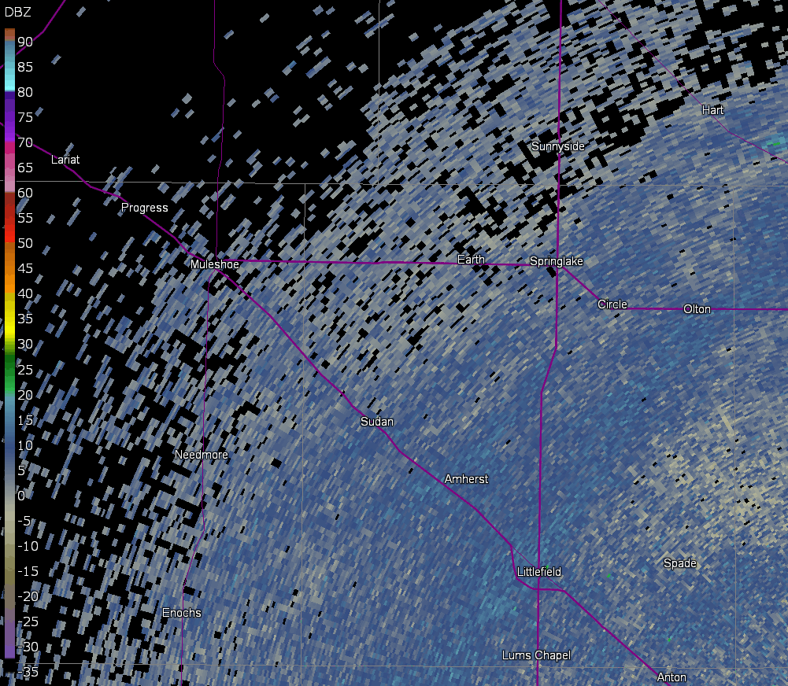
Straight Hodograph
Neither RM nor LM enhanced/suppressed
Mirror-image splitting cells!

Slide 46
Half-Circle Hodograph
H
Now, let’s do a half-circle hodograph!
Shear Vectors
L
H
L
L
Left-Mover
H
Right-Mover
z
North (into page)
east

Slide 47
Half-Circle Hodograph
H
Now, let’s do a half-circle hodograph!
L
L
Left-Mover
H
RM enhanced, LM suppressed!
Upward motion right of initial updraft
Right-Mover
dynamic
lifting!
z
North (into page)
east

Slide 48
Half-Circle Hodograph
H
Now, let’s do a half-circle hodograph!
L
dynamic
subsidence!
L
Left-Mover
H
RM enhanced, LM suppressed!
Downward motion left of initial updraft
Right-Mover
z
North (into page)
east

Slide 49
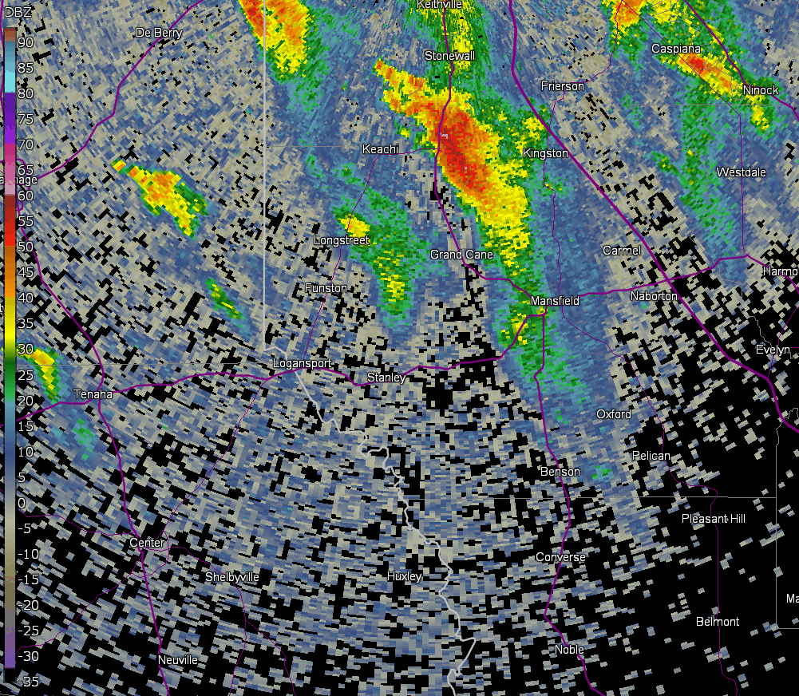
Half-Circle Hodograph
RM enhanced, LM suppressed
No splitting!

Slide 50
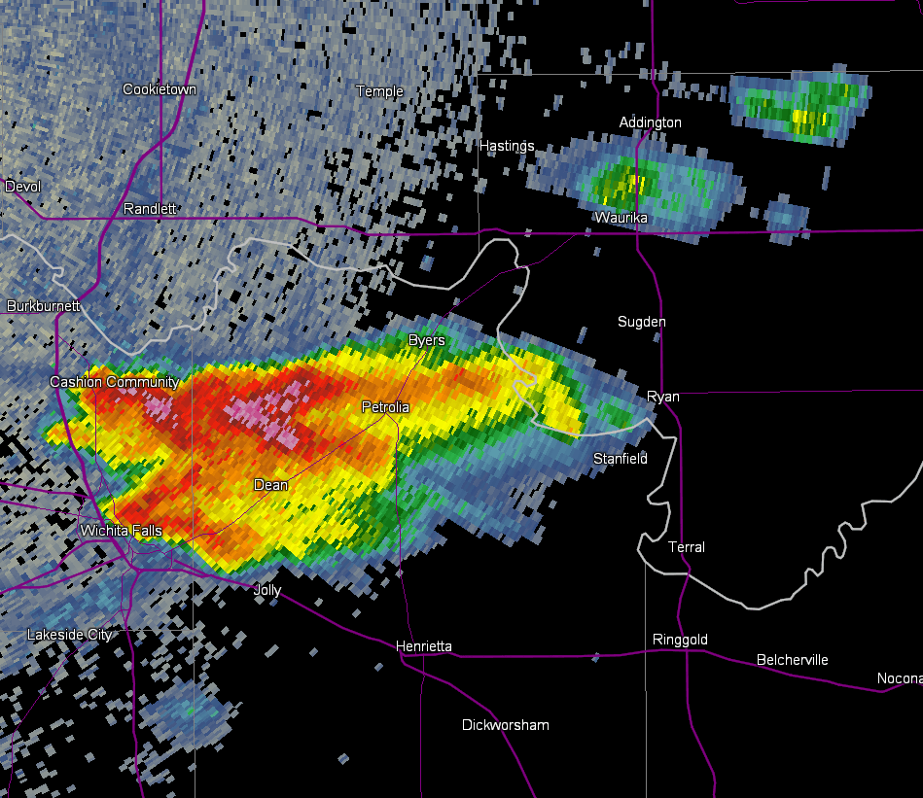
Linear Dynamics Takeaways
Takeaways:
Updraft is enhanced on the concave side,
and suppressed on the convex side.
LM X
RM ✓

Slide 51
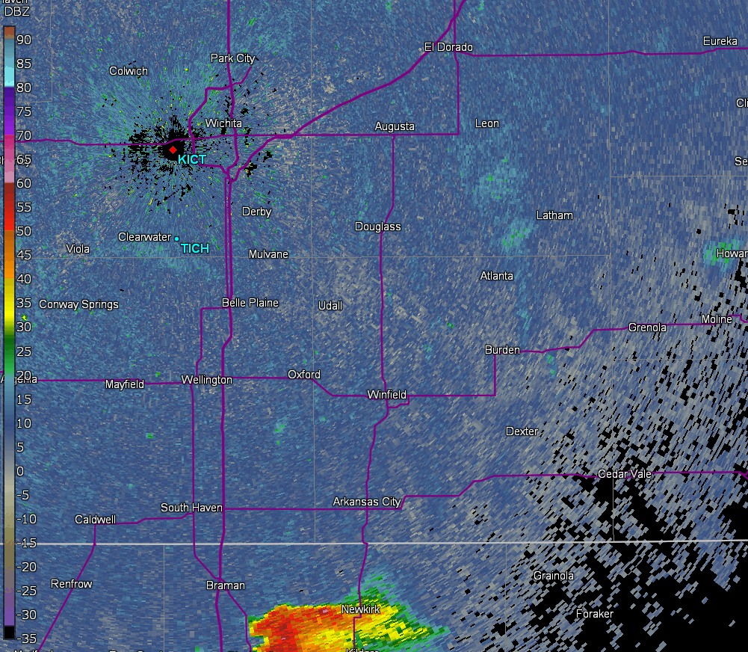
Linear Dynamics Takeaways
Takeaways:
Updraft is enhanced on the concave side,
and suppressed on the convex side.
LM ✓
RM X

Slide 52
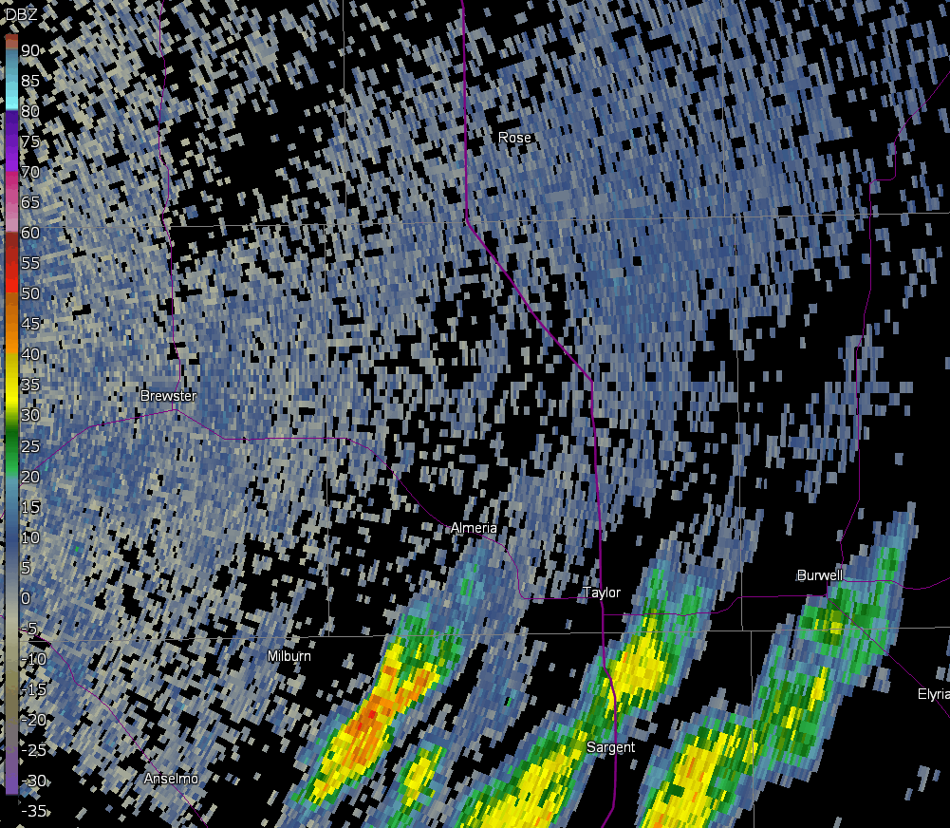
Linear Dynamics Takeaways
Takeaways:
Enhanced upward motion can induce
deviant motion
LM X
RM ✓

Slide 53
Propagation (Deviant Updraft Motion)
For a CURVED hodograph:
Deviant updraft motion (propagation) away from the mean wind is explained by the LINEAR DYNAMICS terms.
LM X
LM ✓
RM ✓
RM X
Updrafts propagate into the region of enhanced storm-scale dynamic ascent

Slide 54
Propagation (Deviant Updraft Motion)
For a STRAIGHT hodograph:
Deviant updraft motion (propagation) away from the mean wind is explained by the NON-LINEAR DYNAMICS terms.
Recall…Splitting storms!
LM
RM
Updrafts propagate away from mean wind due
to tilting of crosswise vorticity

Slide 55
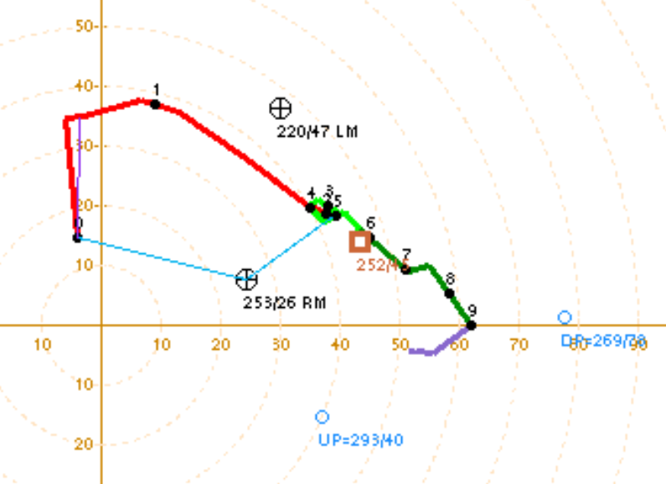
Propagation (Deviant Updraft Motion)
Use Bunkers Storm motion estimates to account for deviant motions!
*Bunkers Storm motion accounts for propagation due to linear AND non-linear dynamics
LM
RM
Notes:
In order to account for this deviant motion to the right, we utilize the Bunkers right-moving supercell motion estimate. The Bunkers storm motion estimates take into account the internal supercell dynamics from both method 1 (in the previous lesson) and method 2. Just be cautious when using these estimates, as you are assuming that an established supercell is present. If the hodograph were shaped counter-clockwise, we would utilize the left-moving supercell motion. When the hodograph is more straight, we utilize both the left and right-mover motions, as cell splitting would encourage both of these deviant motions.

Slide 56
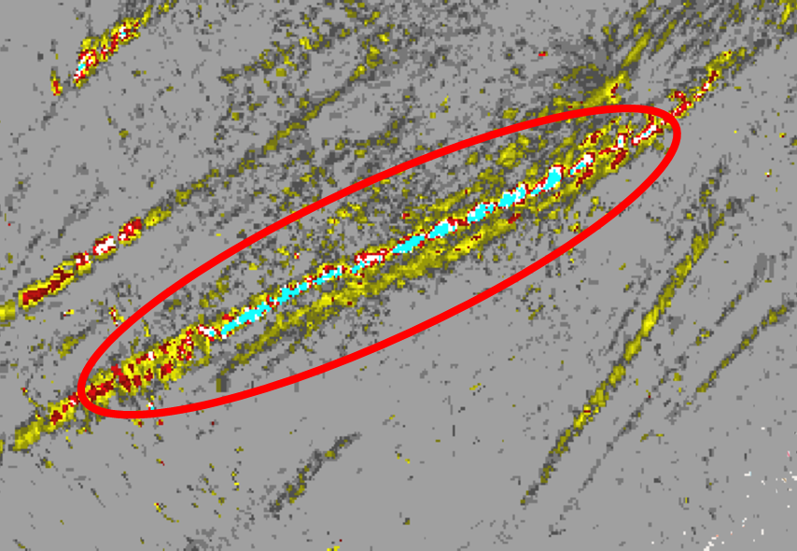
Propagation (Deviant Updraft Motion)
Keep in mind:
Larger, stronger storms can deviate more.
MRMS Rotation Tracks
A larger, stronger supercell may turn
more “right” than a weaker one

Slide 57
Bonus Material – Complex Hodograph Shapes

Slide 58
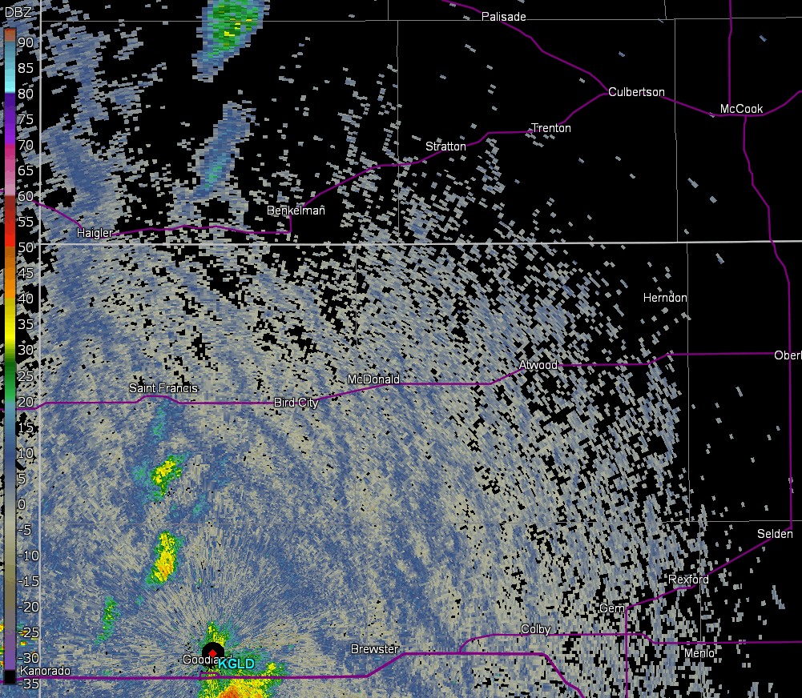
Linear Dynamics and Complex Hodo Shapes– Bonus Material
Updrafts can be enhanced/suppressed
at different levels
LM X
LM ✓
RM ✓
RM X
Notes:
You can imagine that a hodograph with alternating concavities in the vertical could enhance and suppress the right and left movers at different levels via the dynamic effects we have discussed in method 2. In this example, the right-mover is enhanced in the low-levels (where its on the concave side of the hodograph), and suppressed above that (where its on the convex side). The opposite is true for the left-mover. This can have a negative effect on both updrafts, sometimes short circuiting the mesocyclogenesis process. However, in the next part of this lesson, Cameron Nixon will explain why this is not always the case, and the details matter with these complex hodograph shapes.

Slide 59
Linear Dynamics and Complex Hodo Shapes– Bonus Material
Multi-inflection hodographs may
suppress right- and left-movers,
depending on the situation.
Multi-Inflection Hodograph
LM
XX
LM
RM
RM
X
means more lift than
means more suppression than
XX
X
Notes:
Multi-inflection hodographs like this one may suppress right- and left-movers, depending on the situation.

Slide 60
Complex Hodographs
When should we “worry” about dynamic suppression?
Notes:
So when should we worry about this dynamic suppression?

Slide 61
Complex Hodographs
When should we “worry” about dynamic suppression?
Worry about dynamic suppression if alternating concavity
is within the Effective Inflow Layer and relatively large!
Notes:
As a general rule of thumb, we should worry if this inflection is within the effective inflow layer, which is typically in the lowest 3 km.

Slide 62
Complex Hodographs
Strong dynamic suppression on RM (lower in the profile)
This MAY not negatively influence RM, it is higher in the profile.
Notes:
As a general rule of thumb, we should worry if this inflection is within the effective inflow layer, which is typically in the lowest 3 km.

Slide 63
Complex Hodographs
Should we “worry”?
No reason to worry - shear does not reverse
direction with height.
Notes:
So should we “worry” here? Well, here, there’s actually no reason to worry - shear does not reverse direction with height. Also remember: some backing aloft can even help maintain longer-lived mesocyclones!

Slide 64
Complex Hodographs
Should we “worry”?
No worries still - inflection is
well above the effective inflow layer
Notes:
Should we worry here? Nope - the inflection is well above the effective inflow layer and the alternating concavity aloft is small compared to the low-level concavity.

Slide 65
Complex Hodographs
Should we “worry”?
Might not be ideal, but:
Inflection is near the effective inflow layer,
but streamwise vorticity is abundant!
Notes:
How about here? Well, this might not be ideal, since the inflection is near the effective inflow layer, but streamwise vorticity is abundant!

Slide 66
Complex Hodographs
Should we “worry”?
Worry!
Inflection is within the effective inflow layer,
and streamwise vorticity is reduced!
Notes:
But what about here? Yes, you should worry! The inflection is within the effective inflow layer, and to make matters worse, streamwise vorticity is also reduced!

Slide 67
Dynamic Suppression
With which hodograph would you be most concerned about
dynamic suppression on a right-moving storm?

Slide 68
Dynamic Suppression
With which hodograph would you be most concerned about
dynamic suppression on a right-moving storm?
Notes:
Good choice! This one has the most pronounced inflection, it’s near the effective inflow layer, and it reduces streamwise vorticity in that layer!

